Slide 1
Elastic HPC and AI Cloud Orchestration
Bridging Traditional HPC Workflows with Cloud-Native Kubernetes Infrastructure
Rajesh Narayanan | Portland, OR | Engineering Leader in AI & HPC Infrastructure

Slide 2
About Rajesh Narayanan
Rajesh Narayanan (Portland, OR): An engineering leader with 25+ years of experience across Cloud, HPC, AI Infrastructure, and Semiconductor Systems. Formerly an Engineering Manager at Intel, he specialized in scalable design and technical leadership for AI & HPC workloads.
Key Expertise
Kubernetes orchestration
Ansible automation
Led the delivery of the Aurora Supercomputer at Argonne National Laboratory and the Intel Tiber AI Developer Cloud.
Prometheus monitoring
VoltDB analytics
Slurm scheduling
Connect
Embedded software development
linkedin.com/in/rajesh-n-268ba4
Telemetry systems
Project Highlights
Intel Tiber AI Cloud: 25K+ user onboardings, hybrid GPU orchestration.
Aurora Supercomputer: >1 ExaFLOPS, 10,624 nodes, 21,248 CPUs, 63,744 GPUs.
HPC Infrastructure: Kubernetes orchestration, telemetry rollouts.
Telemetry System: Prometheus + VoltDB, Rapid MQ, petabyte/year anomaly detection.

Slide 3
The Challenge: Traditional HPC Limitations
Lack of Elasticity
Poor Resource Efficiency
Integration Gaps
Traditional HPC clusters had fixed resource allocation, lacking dynamic scalability. Resources idled during low utilization; jobs queued during peak.
Static provisioning resulted in over- or underprovisioning, creating bottlenecks. Suboptimal GPU utilization meant expensive hardware was underutilized.
HPC and AI workloads were siloed, using separate orchestration systems. No unified platform connected traditional batch scheduling with cloud-native container orchestration.
Strategic Goal: Integrate HPC batch workloads and AI training jobs into a unified, elastic, cloud-native infrastructure that delivers both reliability and performance at scale.

Slide 4
Solution: Elastic Kubernetes Pods for HPC
Architecture Overview
01
Our solution introduces Elastic Kubernetes Pods (EKP) — a hybrid orchestration model that enables Slurm workload manager to dynamically provision Kubernetes pods as compute nodes. Instead of waiting for bare-metal or VM provisioning, Slurm launches containerized compute pods on-demand, executes jobs, and tears down resources automatically.
User submits job via Jupyter or CLI
02
Slurm Controller receives request
03
Key Innovation: This approach merges HPC-style batch scheduling with elastic, container-based resource management, delivering cloud-native benefits to traditional HPC workflows.
Kubernetes provisions compute pods
04
Pods execute workload with slurmd
05
Resources terminate post-completion
Technical Specifications: 50 compute nodes | 400 GPUs | 200 Gbps network fabric | 1TB RAM per node | 128GB HBM per GPU | NFS/ZFS shared volumes | Support for 2 parallel jobs per GPU | 8 HPC parallel jobs per user

Slide 5
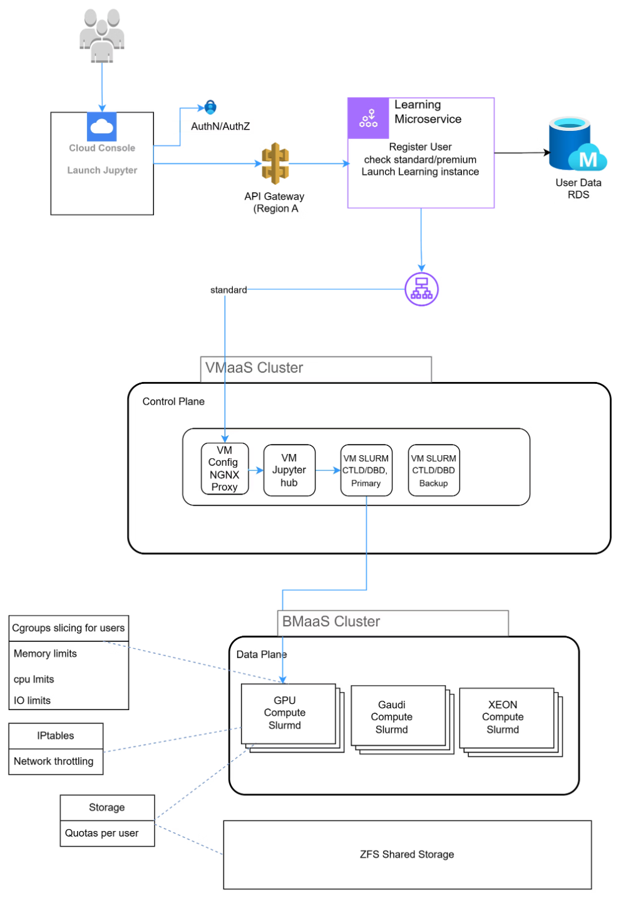
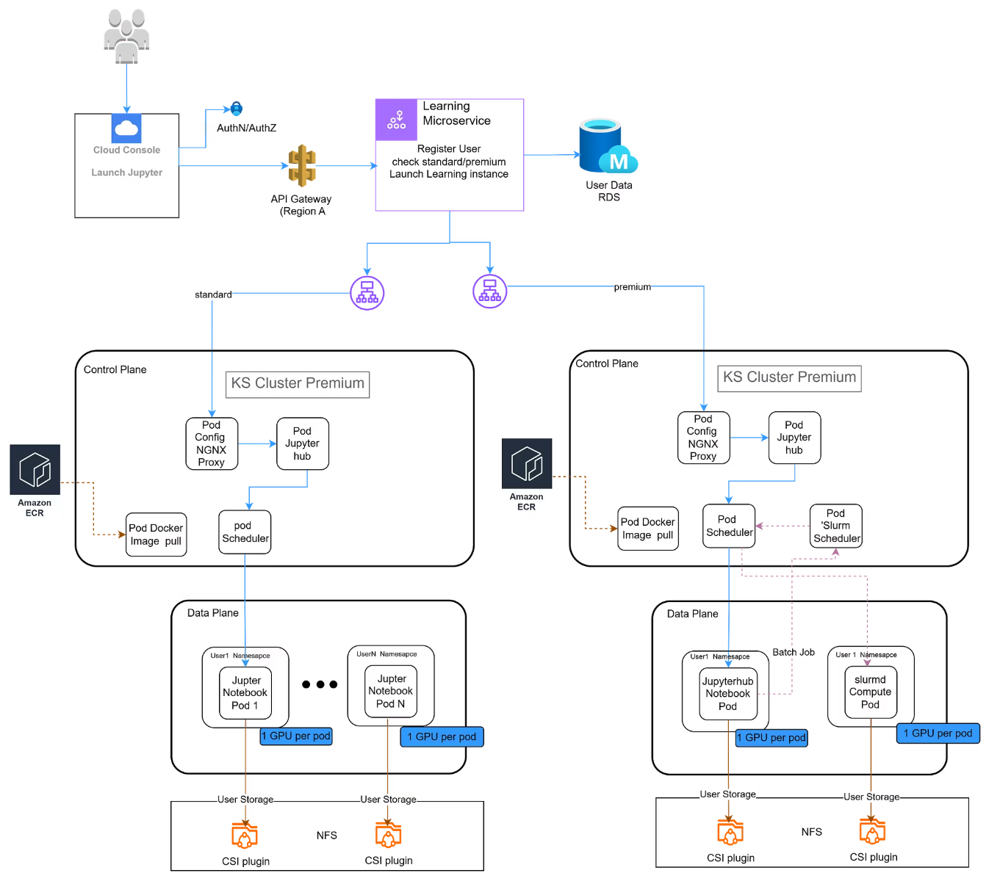
Architecture Evolution: From Bare Metal to Elastic Pods
Previous State
Current State with EKP
Traditional architecture relied on bare-metal servers with static provisioning. Jobs waited in queue for physical resources to become available, leading to poor utilization and extended wait times.
Modern elastic architecture leverages Kubernetes pod orchestration. Compute resources provision dynamically in seconds, scale based on demand, and terminate automatically, maximizing efficiency and throughput.
Transformation Impact: Migration from static bare-metal provisioning to dynamic pod orchestration reduced job start times by 50% while improving GPU utilization by 3×.

Slide 6
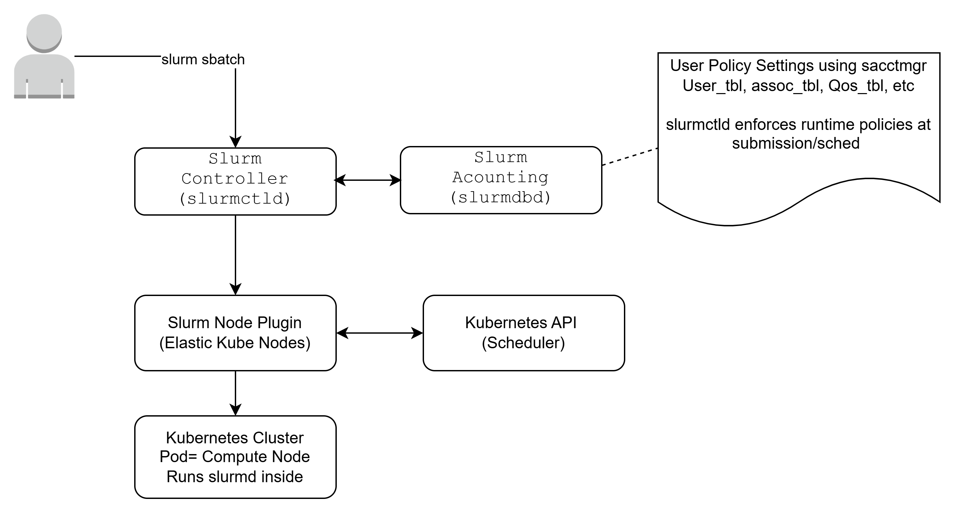






System Architecture: Component Interaction
Slurm Controller
Kubernetes Cluster
Elastic Compute Pods
Manages job queues, triggers elastic provisioning, communicates with Kubernetes, monitors jobs.
Schedules compute pods, provides elastic scaling, manages pod lifecycle and cleanup.
Run slurmd daemon, register as compute nodes, execute workloads, terminate post-job.
Each pod runs a lightweight slurmd daemon, dynamically joining the Slurm cluster as a compute node capable of executing MPI, GPU, and HPC workloads, terminating automatically post-job.

Slide 7
Implementation: Configuration Highlights
Step 1: Build or pull a Slurm Pod Image
Step 3: Configure slurm.conf for Elastic Nodes
Create container image with slurmd, munge authentication, and minimal dependencies. Store in ECR image repository for deployment. Configure slurm.conf to point to the controller.
Update slurm.conf with elastic node definitions. Add the following example snippet:
Step 2: Create Kubernetes Service Account and RBAC
# slurm.conf snippet for elastic nodes
NodeName=elastic[1-100] State=CLOUD
PartitionName=ekp Nodes=elastic[1-100] Default=YES
MaxTime=INFINITE State=UP
Give Slurm permission to create pods using the following Kubernetes YAML configurations:
apiVersion: rbac.authorization.k8s.io/v1
kind: Role
metadata:
name: slurm-elastic
rules:
- apiGroups: [""]
resources: ["pods"]
verbs: ["create", "delete", "list", "get"]
---
apiVersion: rbac.authorization.k8s.io/v1
kind: RoleBinding
metadata:
name: slurm-elastic-binding
roleRef:
kind: Role
name: slurm-elastic
apiGroup: rbac.authorization.k8s.io
subjects:
- kind: ServiceAccount
name: slurm
namespace: default
Step 4: Add Slurm Prolog Plugin
Configure slurm.conf to use a Prolog script for dynamic pod provisioning. Example:
# slurm.conf snippet for prologProlog=/etc/slurm/prolog.sh
Example prolog.sh script (simplified):
#!/bin/bash# Example prolog.sh scriptNODELIST=$SLURM_JOB_NODELIST# Logic to call kubectl to provision pods for NODELIST# e.g., kubectl apply -f pod-template.yaml --selector=slurm.node=$NODELIST
Step 5: Test Job Submission
Submit a test job via sbatch and verify successful execution on elastic nodes.
# Example sbatch commandsbatch --nodes=2 --wrap="hostname"
Verify pod creation in Kubernetes, slurmd registration, workload execution, and automatic pod termination after job completion.

Slide 8



Results and Business Impact
50%
3X
25K+
Faster Job Start
GPU Utilization
Active Users
Reduced provisioning time from minutes to seconds with dynamic pod creation
Improved resource efficiency through elastic scaling and auto-termination
Successfully scaled Intel Tiber AI Cloud to support enterprise workloads
Technical Achievements
Operational Benefits
Unified orchestration for HPC batch jobs and AI training workloads
Reduced infrastructure costs through efficient resource utilization
Auto-scaling compute infrastructure based on real-time demand
Improved time-to-science for researchers and data scientists
Hybrid cloud capabilities enabling multi-region deployments
Enhanced system reliability with container-based isolation
Seamless integration with existing Slurm-based workflows
Simplified operations with Kubernetes-native tooling

Slide 9
Alternative Approach: Native Slurm Operator
Kubernetes-Native Slurm Deployment
apiVersion: slurm.schedmd.com/v1alpha1
kind: SlurmJob
metadata:
name: mpi-testspec:
partition: default
tasks: 4
image: ghcr.io/schedmd/slurm:latest command: ["mpirun", "hostname"]
An alternative architecture involves running Slurm entirely inside Kubernetes using the SchedMD Slurm Operator. This approach handles the complete lifecycle of controllers and compute pods through Kubernetes Custom Resource Definitions (CRDs).
Advantages: Simpler for new deployments, leverages Kubernetes-native constructs, reduces external dependencies, provides declarative job definitions.
Trade-offs: Locks architecture to Slurm scheduler, limiting future flexibility to adopt alternative schedulers. Less suitable for organizations with existing Slurm infrastructure requiring gradual migration.
Best Use Case: Greenfield deployments starting fresh with Kubernetes-first architecture and no legacy Slurm infrastructure to maintain.

Slide 10

Case Study: Aurora Supercomputer at Argonne
System Architecture
Advanced Capabilities
Exascale compute system delivered through Intel + HPE + DOE partnership, achieving breakthrough performance milestones for scientific research and national security applications.
Power Management: GEOPM framework for power-aware scheduling under 20 MW budget with real-time energy calculations
Storage Innovation: DAOS Object Store with burst buffers and pre-fetching libraries for extreme I/O performance
10.6K
Multi-OS Architecture: Hybrid kernel design (fat + lightweight) optimized for extreme-scale computing workloads
Compute Nodes
Telemetry System: Prometheus + VoltDB infrastructure sampling every 10 minutes (716KB/node, ~1.6 PB over 4 years)
63.7K
Predictive Analytics: Health modeling and reliability optimization using machine learning on telemetry data
GPUs
1.012
ExaFLOPS
FP64 Linpack

Slide 11
GPU Driver Task Isolation
Overview of mechanisms used by GPU drivers to securely and efficiently isolate user jobs on shared GPUs

Slide 12
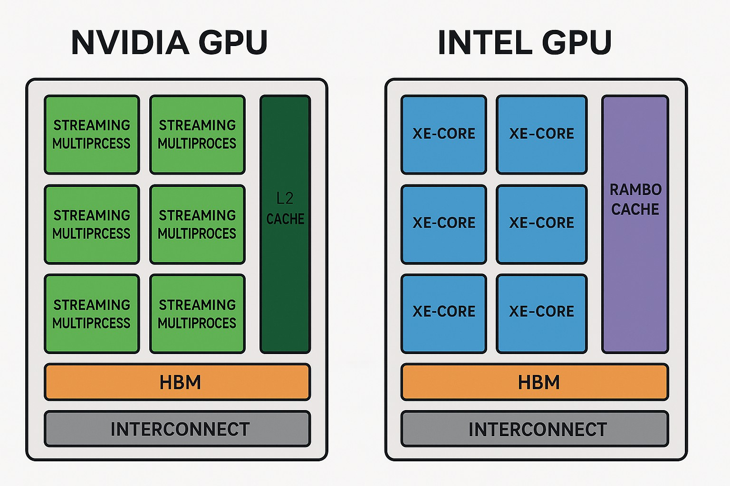
Overview
Modern GPU clusters often share one physical GPU among many jobs.
Isolation prevents one job from interfering with another in terms of security, performance, or stability.
Drivers and hardware enforce this with memory protection, context switching, and partitioning.

Slide 13
Key Isolation Mechanisms
1. Context Management – per-job GPU context (registers, queues, state)
2. Virtual Memory – per-context page tables with IOMMU/SMMU
3. Scheduling & Partitioning – time-slicing and hardware partitioning (MIG, SR‑IOV)
4. Command Queue Isolation – separate, validated queues
5. Preemption & Fault Containment – contain faulty kernels
6. Host-Level Controls – containers, cgroups, schedulers restrict GPU access

Slide 14
Common Flow of GPU Isolation
1. Scheduler assigns a GPU partition or VF to the job
2. Driver creates GPU context and maps memory
3. Commands submitted to isolated queues
4. GPU hardware enforces memory & execution isolation
5. Preemption and error handling contain faults per job

Slide 15
NVIDIA MIG-Based Isolation
NVIDIA Multi‑Instance GPU (MIG) partitions GPU into hardware‑isolated slices.
Each slice has dedicated SMs, L2 cache, and memory.
Each job’s context binds to one MIG slice, ensuring secure and predictable workload separation.

Slide 16
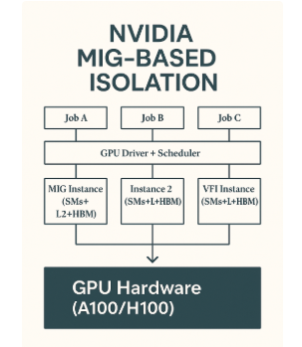

Slide 17
Intel Gaudi / SR‑IOV-Based Isolation
Intel Gaudi GPUs use PCIe SR‑IOV to expose multiple Virtual Functions (VFs).
Each VF has its own queue, DMA engine, and page tables.
Jobs in containers or VMs bind to separate VFs, managed by the PF driver for secure isolation.

Slide 18
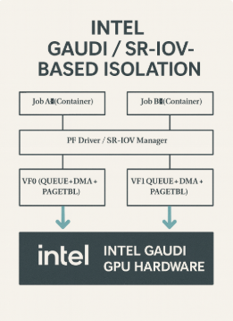

Slide 19
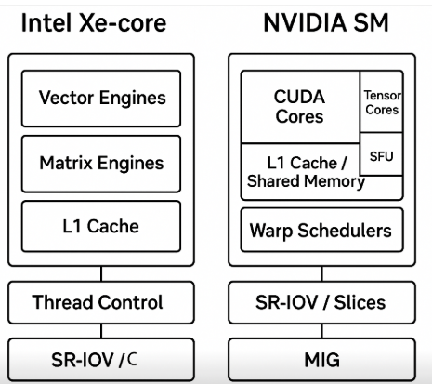
GPU Core Architecture Comparison

Slide 20
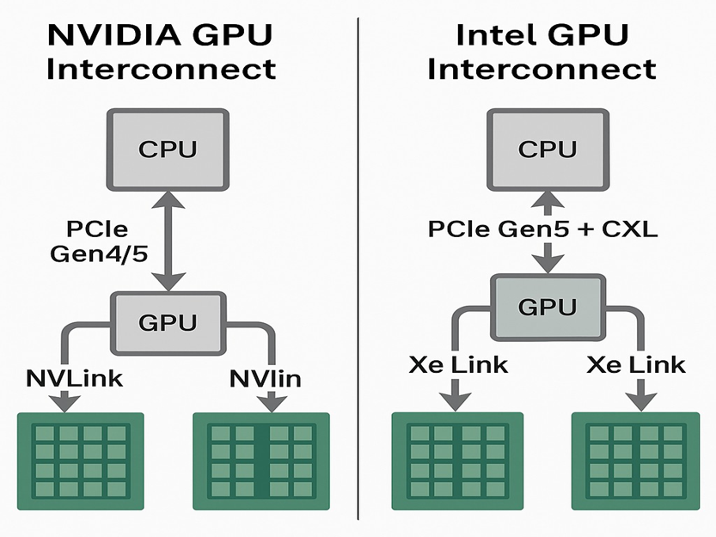
Interconnect Architecture Comparison

Slide 21
Appendix: Acronyms
GPU: Graphics Processing Unit – hardware accelerator for compute and graphics
SM: Streaming Multiprocessor – core compute unit in NVIDIA GPUs
HBM: High‑Bandwidth Memory – fast on‑package memory for GPUs
MIG: Multi‑Instance GPU – NVIDIA feature that partitions a GPU into isolated slices
SR‑IOV: Single Root I/O Virtualization – PCIe technology to virtualize a device into multiple functions
VF: Virtual Function – virtualized GPU instance presented to a VM or container
PF: Physical Function – host‑level GPU function managing all VFs
IOMMU / SMMU: I/O Memory Management Unit / System MMU – hardware for memory protection of DMA
DMA: Direct Memory Access – allows GPU to access host or device memory directly
RAS: Reliability, Availability, and Serviceability – hardware error detection and reporting framework
SMT / Preemption: Simultaneous Multithreading / Preemption – techniques for scheduling and isolating GPU workloads

